Slide 1
Project Presentation

Slide 2
Evaluation Of Classification Algorithms For Bank Marketing Response Prediction

Slide 3
Objective
Problem Statement
Goal
Increasing number of marketing campaigns has reduced the effects on the general public.
Positive response rates to mass campaigns are typically very low as most people see direct marketing as an intrusion to their privacy.
Understand the success of marketing campaign by building a classifier to predict whether or not a client will subscribe to a Term Deposit.

Slide 4
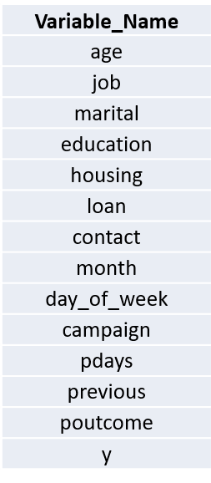
Data Understanding & Exploration
Original Dataset Size: 21 features , ~40k sample observations
Data cleaning:
Duplicates, unknowns, duration and a few economic indicators removed
Sparse variables combined(eg. ‘Retired’ and ‘Unemployed’ under the job variable combined as ‘no_active_income’)
After Pre-processing: 14 features, ~38k sample observations
Low Response Rate (Yes : 11.3% , No: 88.7%)

Slide 5
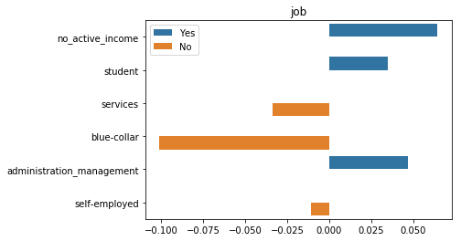
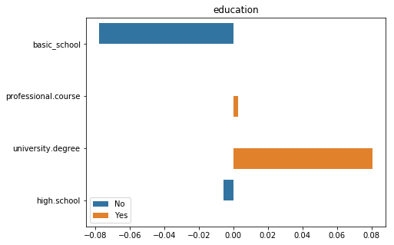
Data visualization – Education & Job
Data by Job Type
Data by Education Level
People with no active income were more inclined to purchase the product.
Mostly customers with a university degree purchased the product indicating a complex product description.

Slide 6
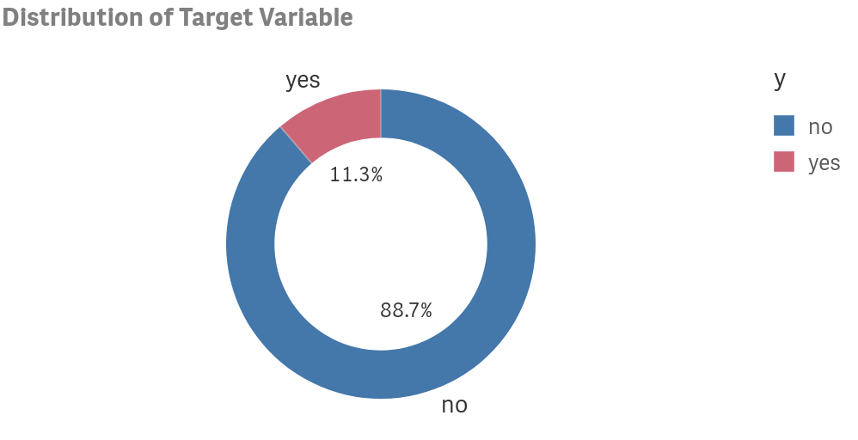
Data Transformation
Low Response Rate
One Hot Encoding and Oversampling
One Hot Encoding was used to transform categorical variables.
To handle data imbalance problem, oversampling technique was used.

Slide 7
Model Performance Evaluation
Imbalanced Dataset : Data with unequal Target Class distribution ( Yes : 11% , No : 88% )
Balanced Dataset : Data with equal distribution of Yes and No classes.
The Accuracy Score for each model is the average of classification accuracy obtained after performing K-Fold Cross Validation on both the datasets.
Balanced Dataset seems to have performed well in most of the cases.
In terms of K-Fold cross validation, Logistic Regression and Random Forest models performed the best.

Slide 8

Hyper Parameter Tuning
Model Parameters are learned during training. Hyper parameters are values that are set before training the model in order to improve the performance.
Hyper parameter tuning was performed using Randomised Search CV Method to tune the performance of two models.
The performance of Random Forest has fallen down. The performance of Logistic Regression model seems almost consistent.

Slide 9
Performance Comparison
Classification Method | F1-Score
Logistic Regression | 0.88
Gradient Boost | 0.88
Extreme Gradient Boost | 0.88
Naïve Bayes | 0.86
Decision Tree | 0.84
Random Forest | 0.82
Classification Method | Recall(Sensitivity)
Logistic Regression | 0.89
Extreme Gradient Boost | 0.89
Gradient Boost | 0.88
Naïve Bayes | 0.85
Decision Tree | 0.84
Random Forest | 0.79
Classification Method | Precision
Gradient Boost | 0.88
Logistic Regression | 0.87
Naïve Bayes | 0.87
Extreme Gradient Boost | 0.87
Random Forest | 0.86
Decision Tree | 0.85
Logistic Regression, Gradient Boost and XG Boost Models have consistently performed well.
These metrics are better when compared to classification accuracy as they take into account the number of positives and negatives.
A score close to 1 indicates a good model.

Slide 10
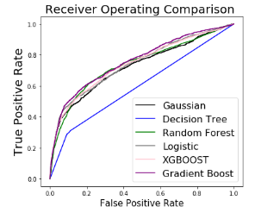
Auroc Curves
In terms of AUROC scores Gradient Boost (AUC=0.76) is the best performing model followed by XGBOOST.
Although in terms of accuracy Random Forest algorithm performed best, accuracy cannot be the sole performance metric for imbalanced datasets.

Slide 11
Conclusions
Model Performance : For an imbalanced dataset, classification accuracy cannot be the sole metric for evaluating the performance of the model. In this project AUC Score, Precision, Recall and F1-Scores have proved to be better performance metrics.
Feature Importance: Age, Job, Education, Type of Contact and Previous Campaign Details proved to be very important.
Recommendations : Future Campaigns should focus more on people who were contacted earlier. Also focusing on students and old people can improve the number of subscriptions.

Slide 12
QUESTIONS!

